Slide 1
Chapter 4: Preoperative Preparation and Intraoperative Monitoring
By Eyayalem M. (Assistant. Professor :April 2025)

Slide 2
Preoperative…..
The wide spectrum of physiologic changes occurring during thoracic surgery puts patients at great risk of developing postoperative complications
Sever conditions producing this complication such as: -
Smoking:
Infection
Bronchial Secretions& poor hydration
Wheezing and unable Bronchodilation

Slide 3
Preoperative….
a) Smoking:
Associated with lung and heart diseases
Increases airway irritability,
Decreases mucociliary transport and
Increases air way secretions
Increases Carboxyhemoglobin level
Has Nicotine

Slide 4
Smoking
Nicotine, which is a sympathomimetic drug that causes the release of catecholamines and increases heart rate, cardiac contractility, constricts cutaneous and coronary blood vessels and increases blood pressure. may it have rebound effect.

Slide 5
Preoperative…
Cessation of smoking
for 2-3 months →improves in ciliary function,
→ improves closing volume, and →
→ reduction in sputum production

Slide 6
Preoperative….
for a period of longer than 4 - 6 weeks before surgery - decreases incidence of post operative
complications.
- for 48 hours before surgery has been shown to
decrease the level of carboxyhemoglobin,
b) Infection: - Acute or chronic infection should
be vigorously treated before surgery.
- Broad spectrum antibiotics are
commonly used.

Slide 7
Preoperative
c) Hydration and removal of Bronchial Secretions:-
Correct hypovolemia and electrolyte imbalance
hydrating the patient decreases the viscosity of the bronchial secretions and facilitates their removal from the air ways.
The use of mucolytic drugs or oral expectorants (potassium iodide) can be benefit to patients with viscous secretions

Slide 8
Preoperative
Postural drainage, vigorous coughing, chest percussion, deep breathing and the use of incentive spirometer can use to remove secretions.
d) Wheezing and Bronchodilation
The presence of acute wheezing represents a medical emergency, and elective surgery should be postponed until effective Proper treatment has been instituted.

Slide 9
Preoperative
The efficacy of bronchodilators in reversing the bronchospastic component is extremely important.

Slide 10
Intra Operative Monitoring
All patients undergoing thoracic surgical procedures require the standard monitoring
Pulse Oximetry is standard of care during thoracic surgery because hypoxemia may occur during one lung ventilation
- Dysrhythmias occur commonly both during
and after thoracic surgery so needs
continuous ECG

Slide 11
Intra Operative…..
Dysrhythmias may be
due to cardiac manipulation.
a sign of inadequate oxygenation or ventilation.
related to sympathetic nervous system stimulation from pain .
to reduced pulmonary vascular bed from the lung resection.

Slide 12
Intra Operative…..
Invasive Monitoring important for thoracic surgery are.
1. Direct Arterial Catheterization
2.Central Venous Pressure Monitoring (CVP)
3. Pulmonary Artery Catheterization (PA)

Slide 13
Intra Operative…..
1-Direct arterial catheterization –
It allows
For continuous Beat to beat BP analysis
Sampling for determination of ABG
For mediastinoscopies, monitor compression of Rt. innominate artery via Rt. radial arterial line

Slide 14
Intra Operative…..
2-CVP monitoring/measure
To Measure Rt. atrial & ventricular pressure.
*Useful in – large volume shift & hypovolemia
need for vasoactive drug.
Insertion of a transvenous pacemaker where necessary
- It reflects the patients Blood Volume, venous tone, and right ventricular performance;
it is also affected by central venous obstruction and alterations of intrathoracic pressure (e.g. PEEP).
.

Slide 15
Intra Operative…..
The CVP reflects right-sided heart function and not left ventricular performance.
The CVP catheter can be placed centrally from either the
- external or the internal Jugular Vein,
- from the subclavian veins or
- from one of the arm veins.
- The success ratio is highest using the right internal jugular vein

Slide 16
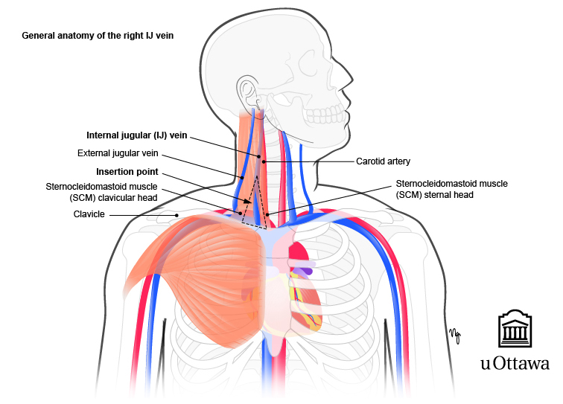

Slide 17
Intra Operative…..
The major disadvantage of using
-the external Jugular vein during thoracotomy is the catheter often kinks in LDP.
- The subclavian technique leads to a high
incidence of pneumothorax that can be
disastrous if it occurs in the dependent lung
during one-lung ventilations.

Slide 18
Intra Operative…..
3. Pulmonary Artery Catheterization (PA)
PA catheter allows measurement of left-sided filling pressures.
Indications for PAC in Thoracic Surgery
1. Patients with known cardiovascular disease, with
or without heart failure
2. Surgery of in which cross clamping of the thoracic aorta is anticipated
3. Patient with respiratory failure
4. Patient with suspected or diagnosed pulmonary
emboli

Slide 19
Intra Operative…..
Patient who have undergone previous cardiac surgery.
When pneumonectomy is anticipated
When significant shifts of intravascular volume are anticipated
When sepsis is present
Patients with pulmonary hypertension or elevated pulmonary vascular resistance.

Slide 20
Intra Operative…..
The PAC is most reliably inserted via the right internal jugular vein.
Complications of PAC Insertion
A) Immediate Complications
Supraventricular and ventricular dysrhythmias during insertion.
Onset of a right BBB and/or complete heart block in patients with a preexisting left BBB.

Slide 21
Intra Operative…..
-Arterial puncture
- Pneumothorax
- Nerve damage
- Thoracic duct injury

Slide 22
Intra Operative…..
B) Long term complications of the PAC
- Pulmonary infarction
- Pulmonary artery rupture
- Knotting of the catheters in the right
ventricles
- Infection
- Vascular obstruction

Slide 23
Thank you!!!

